Slide 1

Agenda
UNECE Convention on Long-range Transboundary Air Pollution
General cost methodology
Calculation of boiler outlet emission loads
Economic assessment of DeNOx technologies
Economic assessment of dedusting technologies
Economic assessment of DeSOx technologies

Slide 2

UNECE Convention on Long-range Transboundary Air Pollution
IED ELVs and Dust emission issues in coal power plant
Existing plants |  | New plants
Power (MW) | ELV (mg/Nm3) | Power (MW) | ELV (mg/Nm3)
50-100 | 30 | 50-300 | 20
100-300 | 25
>300 | 20 | >300 | 10
Economic assessment of Dedusting technologies

Slide 3
UNECE Convention on Long-range Transboundary Air Pollution
Specific cost methodology for Deduster
Adapted methodogy from US EPA Air pollution cost control manual
Investment cost
Variable operating cost
 | Fabric Filter | Electrostatic Precipitator
C_{equip} | 1.Baghouse compartments 2.Bags 3.Cages | General equipment
 | 0.74 | 0.67
 | 0.45 | 0.57
C_{op,var} | 1.Bag replacement 2.Compressed air consumption 3. Fan consumption | 1.ESP power requirement 2.Fan consumption 3. SO₃ consumption
Economic assessment of Dedusting technologies

Slide 4
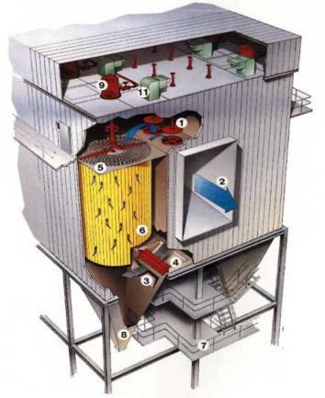
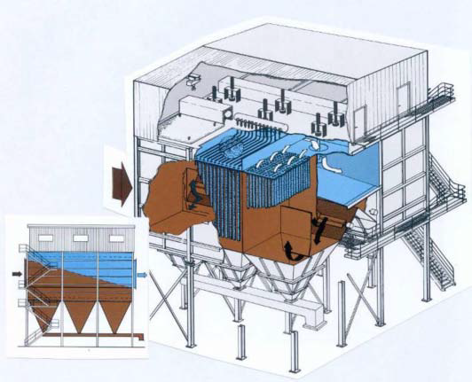
UNECE Convention on Long-range Transboundary Air Pollution
Pulse Jet Fabric Filter
Economic assessment of Dedusting technologies

Slide 5
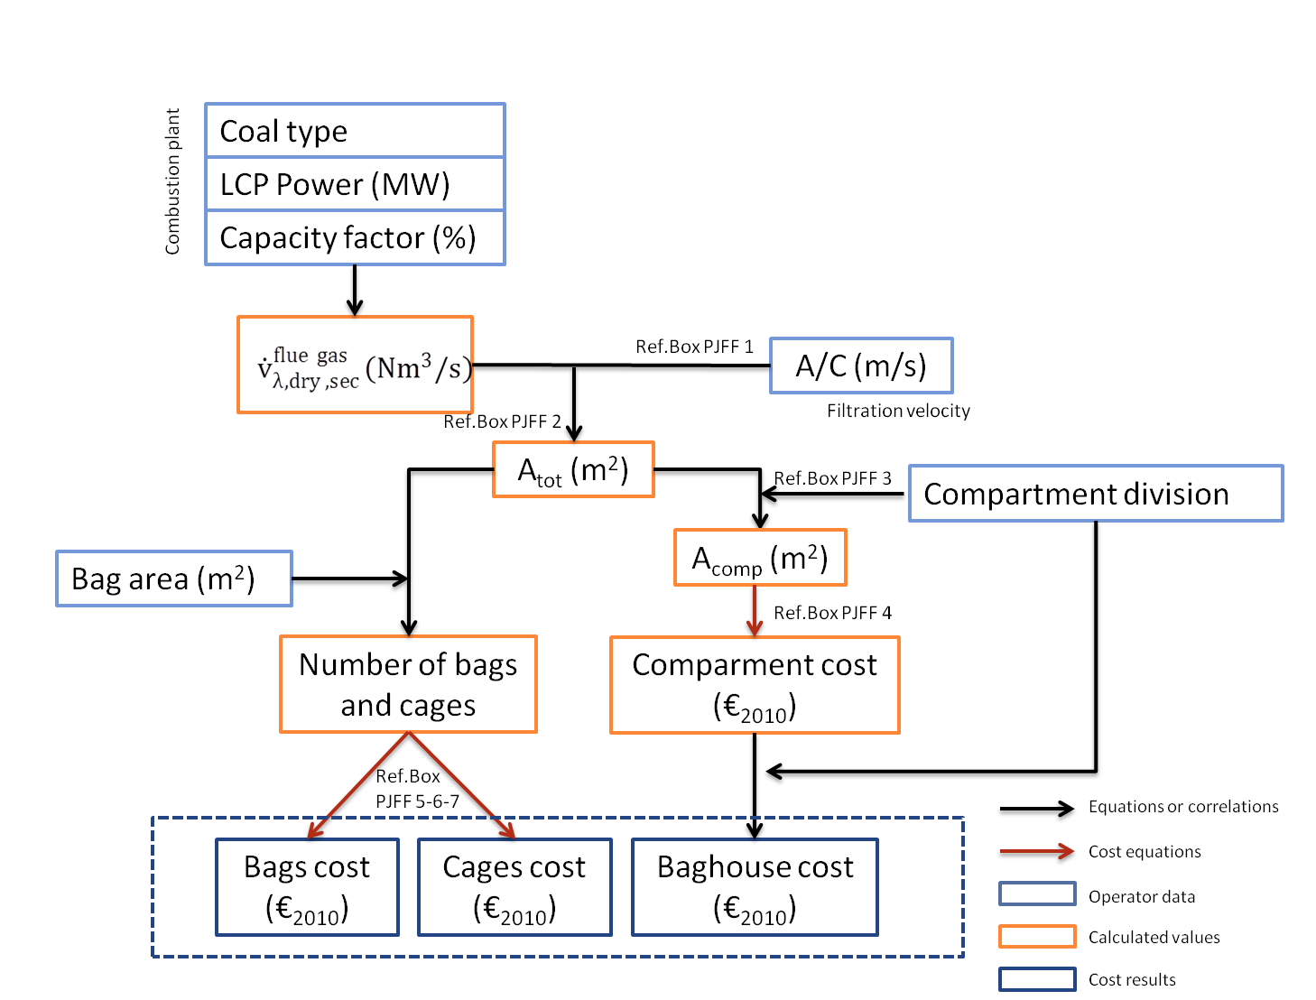
General approach for Pulse Jet Fabric Filter equipment cost
UNECE Convention on Long-range Transboundary Air Pollution
Logic Tree
Economic assessment of Dedusting technologies

Slide 6
Total filtration area calculation and industrial example
UNECE Convention on Long-range Transboundary Air Pollution
Industrial example from Termokimik¹
  Power 660 MWe => 1,650 MWth
  Volumetric flow gas = 1,750,000 Nm³/h
  A/C = 1.11 cm/s
  A_{NC} = 45,900 m²
  A_{GC} = 47,736 m²
  16 compartments => Acomp = 2,984 m²
¹Available online : http://www.termokimik.it/pdf/torrevaldaliga_eng.pdf
Economic assessment of Dedusting technologies

Slide 7
Cost comparison for Pulse Jet Fabric Filter units
Variable input parameters and comparison with literature data
UNECE Convention on Long-range Transboundary Air Pollution
Parameter | Value
A/C (m/s) | 1.8e-2
Number of compartments | Division made in order to get A_{comp} = 2,500 m²
Number of extra-compartments | Bettween 0 and 2
Compartement baghouse | Stainless steel Insulated
Filtering media | RT
Reference price for PE media (€) | 9
Bag dimension | Lenght : 8m Diameter : 150 mm
Cage price (€/m2) | 20
Economic assessment of Dedusting technologies

Slide 8
Air to Cloth ratio influence and industrial values
UNECE Convention on Long-range Transboundary Air Pollution
Industrial example | Air to cloth ratio (m/s)
Termokimik | 0.011
Balcke Dürr | 0.014
GE Energy | 0.014 – 0.017
Lurgi | 0.014 – 0.0167
Otter Tail Power Company | 0.0172
For a 1000 MWth combustion plant
Economic assessment of Dedusting technologies

Slide 9


Operating Cost for Pulse Jet Fabric Filter and Efficiency
UNECE Convention on Long-range Transboundary Air Pollution
Economic assessment of Dedusting technologies

Slide 10
Operating Cost for Pulse Jet Fabric Filter
UNECE Convention on Long-range Transboundary Air Pollution
Specific dust reduction cost = total cost per year / dust emission saved per year
Utility electricity cost : Fan consumption and comrpessed air consumption
Bag replacement : assuming 20,000 hours of bag lifetime
Economic assessment of Dedusting technologies

Slide 11
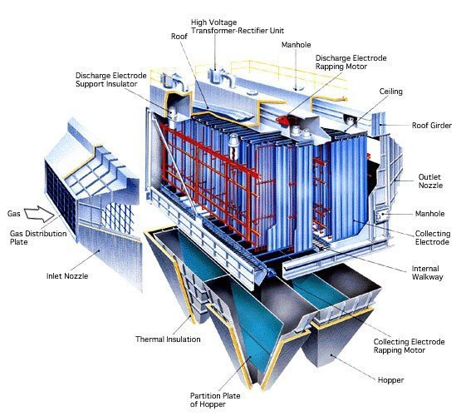
Electrostatic Precipitator
UNECE Convention on Long-range Transboundary Air Pollution
Economic assessment of Dedusting technologies

Slide 12
General approach for ESP equipment cost
UNECE Convention on Long-range Transboundary Air Pollution
Logic Tree
Economic assessment of Dedusting technologies

Slide 13
Effective collecting plate area determination from method 2
UNECE Convention on Long-range Transboundary Air Pollution
k = 1
k = n
n = number of ESP fields
MMD₁=MMD_{in}
SCA₁
A_{ECP,1}
MMD_{n}
SCA_{n}
A_{ECP,n}
Economic assessment of Dedusting technologies

Slide 14
Evolution of SCA as a function of MMDin and T
UNECE Convention on Long-range Transboundary Air Pollution
T (K)
CUECost workbook : 50 s/m < SCA <190 s/m
Schwarze Pumpe: SCA =117.4 s/m [Balcke Dürr]
Waigaoqiao : SCA = 85.6 s/m [Balcke Dürr]
Baclke Dürr : SCA = 226 s/m
Economic assessment of Dedusting technologies

Slide 15
Cost comparison for ESP units
Variable input parameters and comparison with literature data
UNECE Convention on Long-range Transboundary Air Pollution
Parameter | Range choice
Efficiency [η] (%) | 99.89
Temperature [T] (K) | 400
Mass Mean diameter [MMDin] (µm) | 12
ESP specific equipment | Yes
ESP material | Stainless steel 304
SO3 injection precaution | Yes
Economic assessment of Dedusting technologies

Slide 16
Operating Cost for ESP units
UNECE Convention on Long-range Transboundary Air Pollution
Specific dust reduction cost = total cost per year / dust emission saved per year
Utility electricity cost : Fan consumption and ESP power requirement
SO₃ consumption : assuming precaution injection at 35 kg/h
Economic assessment of Dedusting technologies

